Slide 1
Applications of
fuzzy set theory:
Fuzzy control

Slide 2

Fuzzy control
A conventional feedback control
noise
setpoint
Process
output
e
Controller
u
Process
+
measured
value
Primary
Detector
-uses the input-output behavior of the process to generate the
control actions
based on simplified physical models of process. Unable to control
a process which can not be modeled (inherent nonlinearities,
time-varying nature of processes, unpredictable environmental disturbances,…)
needs a solid theoretical and mathematical background
time-consuming

Slide 3
Fuzzy control (cont’d)
A fuzzy controller
Objective :
  control complex processes by means of human experience.
difference between FLC and expert systems:
  Used for controlling technical processes (unlike expert systems which try to exploit uncertain knowledge acquired from an expert)
some interesting points of FLCs:
  cheap, easy to design, robust, capable of outperforming conventional control systems
the compositional rule of inference can be considered as the spine of all FLC models
uses rules to model the process
  such rules links input variables with the control variables by terms of linguistic variables:
if the temperature is slightly too high, increase a bit the heating power

Slide 4
Fuzzy control (cont’d)
A general FLC consists of 4 modules:
(fuzzification, rules, inference engine, defuzzification)
noise
Fuzzifi-
cation
Inference
engine
x
w
e
terms
Controller
Defuzzi-
fication
u
Process
terms
+
Rule Base
Primary
Detector
measured value
for a rule such as
if the tempreture is slightly too high, increase a bit the heating power
“increasing a bit” is translated to a crisp control action by the defuzzifier

Slide 5
Fuzzy control (cont’d)
Design of fuzzy controllers
-step 1:
after identifying relevant input output variables of the controller, we have to select meaningful linguistic terms for each variable and express them by appropriate fuzzy sets (usually fuzzy numbers)
-step2:
introducing a fuzzification function for each input variable to express the associated measurement uncertainty
-step3:
formulating the knowledge pertaining to the given control problem in terms of a set of fuzzy inference rules (either by eliciting from experienced human operators or by obtaining from empirical data)
-step4:
designing an inference engine which must properly combine measurements of input variables with relevant fuzzy information rules
-step5:
selecting a suitable defuzzification method to convert each conclusion obtained in terms of a fuzzy set, to a single real number

Slide 6
Fuzzy control (cont’d)
Fuzzification function
Fuzzy variables are usually chosen to be one of the following forms:
μ
μ
x
x
triangular
linear
μ
μ
x
x
Gaussian
trapezoidal

Slide 7

Fuzzy control (cont’d)
Fuzzy inference,
Inference mechanisms
- decomposition of rule base
  The rule base has the form of a MIMO (multiple input
  multiple output) system.
  : (A_{i} × … × B_{i}) → (z₁ + … + z_{q})
  The premise forms a fuzzy set in the product space U × … ×V
  and the consequence is the union of q independent control actions
  These rules can be decomposed as MISO systems:
  : (A_{i} × … × B_{i}) → (z₁)
  (A_{i} × … × B_{i}) → (z₂)
  ….
  (A_{i} × … × B_{i}) → (z_{q})

Slide 8
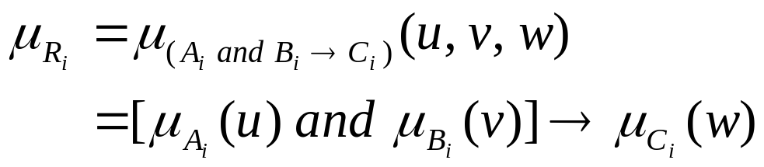
Fuzzy control (cont’d)
let’s consider two-input/single-output rule base, we will extend it to MISO rule base
  R_{i}: (A_{i} and B_{i}) → C_{i}
  where “A_{i} and B_{i}” is a fuzzy set A_{i} × B_{i} in U × V.
R_{i}: (A_{i} and B_{i}) → C_{i} is a fuzzy implication relation in U × V × W, and → denotes a fuzzy implication function

Slide 9
Fuzzy control (cont’d)
Compositional rule of inference
  Let’s consider a single fuzzy rule and its inference
R₁: if v is A then w is C
Input: v is A′ Result: C′
A ⊂ U, C ⊂ W, v ∈ U, and w ∈ C.
input A′ is given to the inference system,
the output C′ is obtained as: C′ = A′ ο R₁
From now on, we introduce different inference mechanisms
Using two simple compositional rules:
Mamdani composition: max-min
Larsen composition: max-product

Slide 10
Fuzzy control (cont’d)
Lemma 1: (For 1 singleton input, result C′ is obtained from C and matching degree α₁ )
When a fuzzy rule R₁ and singleton input u₀ are given
R₁ : If u is A then w is C, Or R₁ : A → C
inference result C′ is defined by the membership function μ_{C′}(w)
μ_{C′}(w) = α₁ ∧ μ_{C}(w) for R_{C} (Mamdani implication)
where α₁ = μ_{A}(u₀)
μ_{A}
μ_{C}
A
C
α₁
C′
u₀
u
w

Slide 11
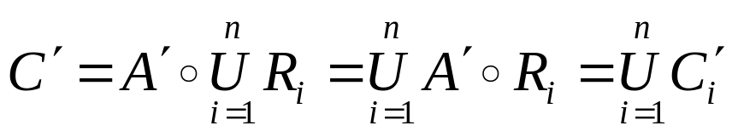
Fuzzy control (cont’d)
Lemma 2: (Total result C′ is an aggregation of individual results)
The result of inference C is an aggregation of result derived from individual rules
μ_{C}(w)
μ_{C}(w)
μ_{C}(w)
R₁: A₁ → C₁
R₂: A₂ → C₂
C₁
C₂
α₁
C′
C₁′
α₂
C₂′
w
w
w
Lemma 2 (Total result C′ is a union of individual result C_{i}′ )

Slide 12
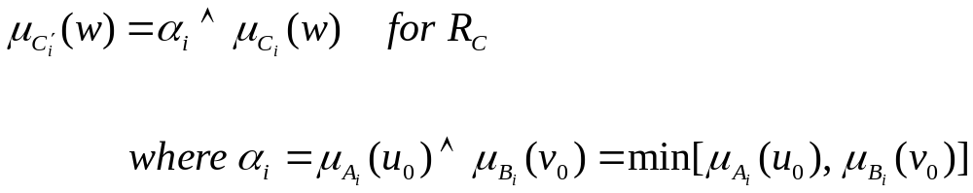
Fuzzy control (cont’d)
Lemma 3: (For singleton input of 2 input rules, C_{i}′ is determined by the
minimum matching degree of A_{i} and B_{i})
If the inputs are fuzzy singletons, namely, A′ = u₀, B′ = v₀, the matching degree α_{i} is the minimum value between μ_{A}(u₀) and μ_{B}(u₀) .
From the lemma 1, the inference result can be derived by employing Mamdani’s minimum operation rule R_{C} and Larsen’s product operation rule R_{P} for the implication

Slide 13
Fuzzy control (cont’d)
min
A_{i}
B_{i}
C_{i}
α_{i}
u₀
u
v₀
v
w
Lemma 3 (α_{i} is the minimum matching degree between A_{i}(u₀) and B_{i}(v₀).)

Slide 14
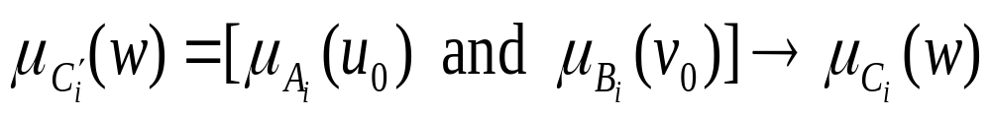

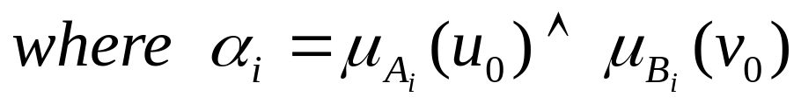
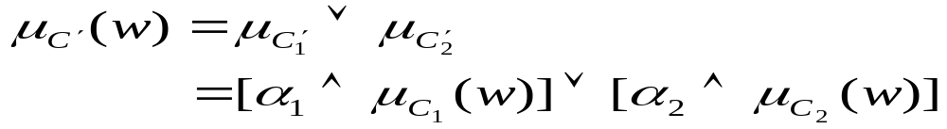
Fuzzy control (cont’d)
(Total result C′ is an aggregation of individual results)
1. When input data are singleton u = u₀, v = v₀
From lemma 3,
From lemma 2,

Slide 15
Fuzzy control (cont’d)
α₁
C₁′
u
v
w
1
C ′
0
α₂
C₂′
u
v
min
w
u₀
v₀
Graphical representation of Mamdani method with 2 singleton inputs

Slide 16
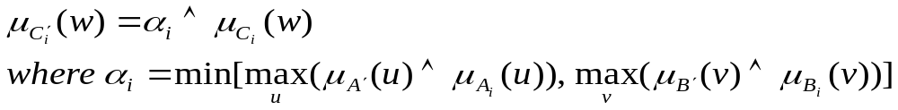
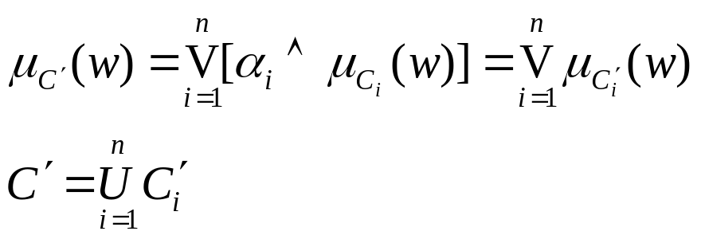
Fuzzy control (cont’d)
Mamdani method
Lemma 4: When input data are fuzzy sets, A′ and B′
From Lemma 2,

Slide 17
Fuzzy control (cont’d)
example
Assume a fuzzy rule base including one rule such as :
R: If u is A then v is B
Where A=(0, 2, 4) and B=(3, 4, 5) are triangular fuzzy sets.
Given a singleton input value u₀=3, how can we calculate the
output B′ using the Mamdani method?
What is the answer if input A′=(0, 1, 2) ?

Slide 18
Fuzzy control (cont’d)
example
Assume a fuzzy rule base including one rule such as :
R: If u is A then v is B
Where A=(0, 2, 4) and B=(3, 4, 5) are triangular fuzzy sets.
Given a singleton input value u₀=3, how can we calculate the
output B′ using the Mamdani method?
What is the answer if input A′=(0, 1, 2) ?
1
1
A
A’
A
1
B
1
B
0.5
0.5
B′
B′
0
2
3
4
3
4
5
0
2
3
4
3
4
5
u₀
Fuzzy inference with input u₀=3
Fuzzy inference with input A′=(0, 1, 2).

Slide 19


Fuzzy control (cont’d)
Larsen method
This method uses the product operator R_{P} for the fuzzy implication and the max-product operator for the composition
R_{i}: if u is A_{i} and v is B_{i} then w is C_{i}, i = 1, 2, … , n
Then
is defined by

Slide 20
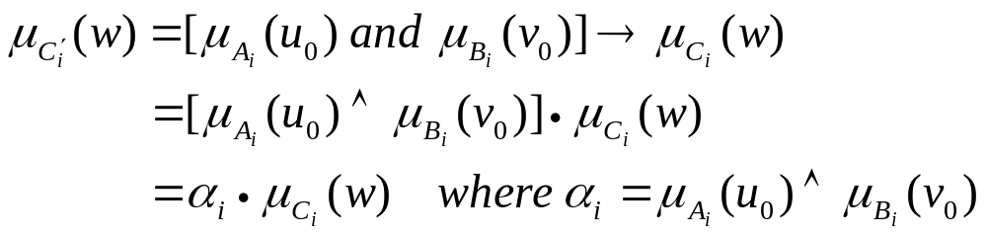
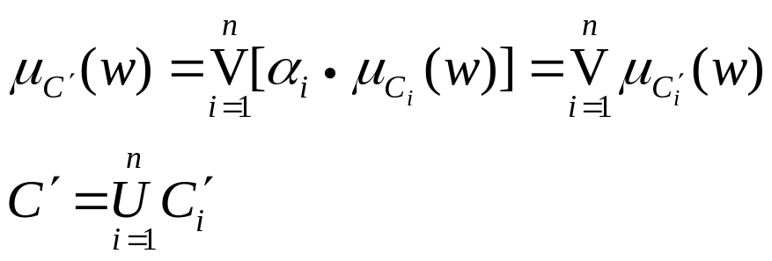
Fuzzy control (cont’d)
Larsen method
This method uses the product operator for the fuzzy implication and the max-product operator for the composition
1. When the singleton input data are given as u = u₀, v = v₀
from Lemma 3
From Lemma 2

Slide 21
Fuzzy control (cont’d)
1
1
1
α₁
0
0
0
u
v
w
1
1
1
1
0
w
α₂
0
0
0
u
v
min
w
u₀
v₀

Slide 22
Fuzzy control (cont’d)
example
There is a fuzzy rule :
R : if u is A and v is B then w is C
Where A=(0, 2, 4), B=(3, 4, 5) and C=(3, 4, 5)
Find inference result C′ when input is u₀ =3, v₀=4 by
using Larsen method
Find inference result C′ when input is A′=(0, 1, 2) and
B′=(2, 3, 4).

Slide 23
Fuzzy control (cont’d)
1
A
1
1
B
C
0.5
C’
2
3
4
3
4
5
3
4
5
u₀
v₀
Larsen method with input u₀ =3, v₀=4
A′
1
A
1
B′
1
B
2/3
C
0.5
C’
0
1
2
4
2
3
4
5
3
4
5
Larsen method with input A′=(0, 1, 2), B′=(2, 3, 4).

Slide 24
Fuzzy control (cont’d)
Defuzzification method
Conceptually, a defuzzification method aims to determine a crisp point which represents best a fuzzy set.
These methods are based on heuristic ideas like:
“take the action that corresponds to the maximum membership”
“take the action that is midway between two peaks or at the center”
…
Measures for choosing a defuzzification method :
- plausibility
- simplicity of calculation
(specially important for real time controllers)
- continuity
(a small change in fuzzy set should cause a small change
in the resulting crisp point)

Slide 25
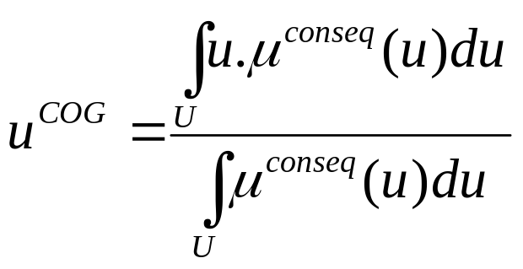
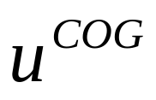
Fuzzy control (cont’d)
- Center of Gravity (COG) or center of area
u

Slide 26
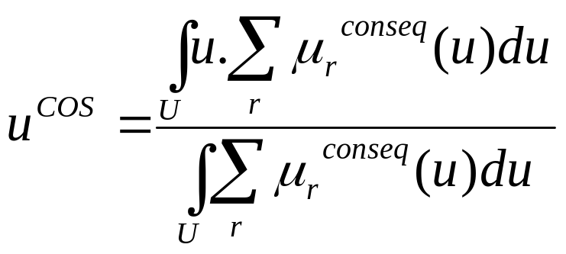
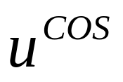
Fuzzy control (cont’d)
Center of Sums (COS)
  Simplified version of SOG (considers the resulting fuzzy set of each rule evaluation individually)
u

Slide 27
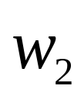
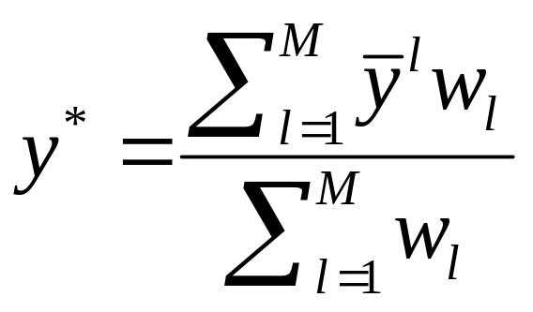

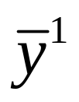
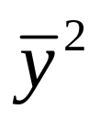
Fuzzy control (cont’d)
Center Average (CA)
  Weighted average of the centers of fuzzy sets
u

Slide 28
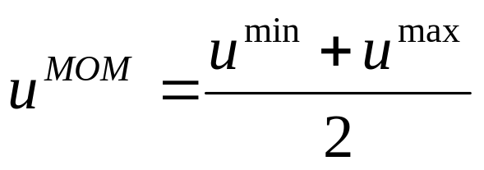
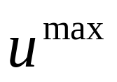
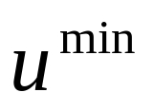

Fuzzy control (cont’d)
Mean of Maxima (MOM)
  Considers only the part of the consequence fuzzy set with maximal degree of membership
u

Slide 29
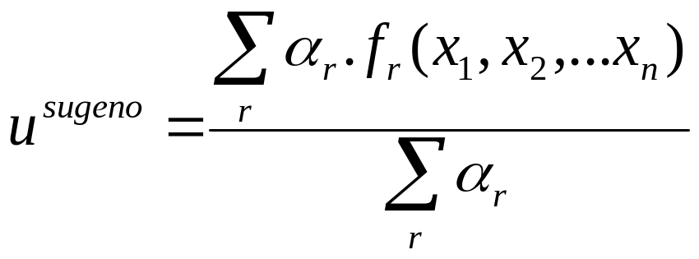
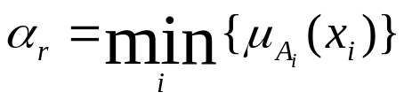
Fuzzy control (cont’d)
(used in Sugeno controller)
  Rules have fuzzy premises and crisp consequences that are functions of input variables: u=f_{r}(x₁,x₂,…,x_{n})
with the matching degree α_{r} :

Slide 30
Fuzzy control (cont’d)
Comparing defuzzification methods
 | COG | COS | CA | MOM
plausability | yes | yes | yes | yes
Simplicity of calculation | no | yes | yes | yes
continuity | yes | yes | yes | no

